Slide 1
Pray
NEW BOOK! YAAAY!
OPEN YOUR BIBLE Book of “Nehemiah"
Chapter 1
Notes:
GUIDE ON USING THIS SLIDE: This slide should always be there on every lesson.
No need for any slide change.
PURPOSE OF SLIDE: EACH AND EVERY TIME we remind the kids and down the road say-along together
This is planting in them “HOW WE READ THE BIBLE”
Why do this each and every week?
WE WANT TO ENGRAVE THOSE STEPS IN THE KIDS MIND TO HOW THEY READ THE BIBLE

Slide 2
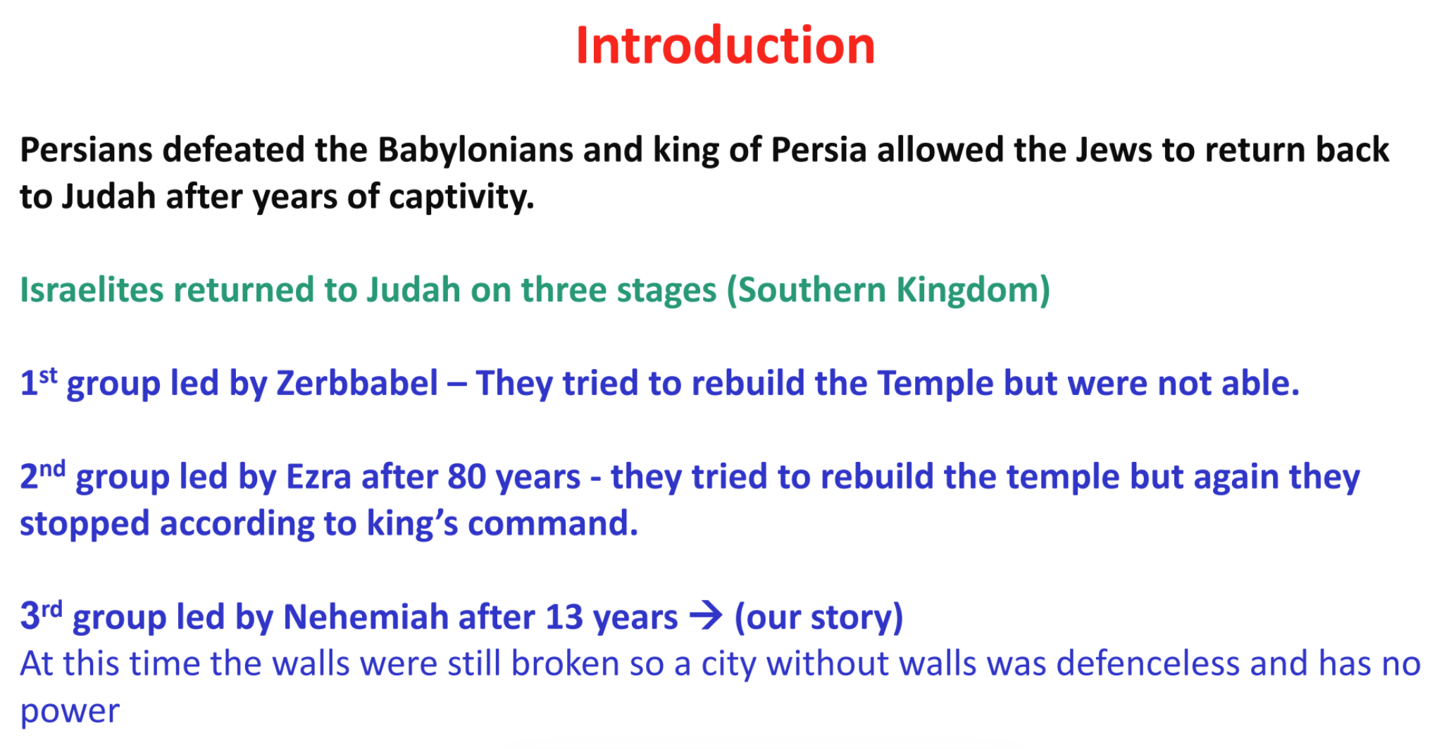
Nehemiah
(A call to rebuild)
Notes:
GUIDE ON USING THIS SLIDE: Just replace the verse and keep font-size the same
PURPOSE OF SLIDE: Guide the class servants and kids for the exact bible verses to read HOW TO OPERATE & TIPS:
- Children will sit on a circle and each child will read one verse
- Servants will guide, encourage and Support the kids – BUT Kids HAVE TO BE the ones reading.
- Tip to servant: Establish environment of RESPECT to anyone who reads even if they have less reading skills, set the stage upfront and let the kids know that GOD WILL LOVE TO HEAR THEIR READING regardless of how good they are.

Slide 3
Video Time
https://www.youtube.com/watch?v=S5Y0P6Mpbqo&t=657s
Watch
From beginning minutes 0:00 to 3:00
Notes:
Close-off with excitement and love and instruct the kids to go back to the front-desk to get back their passports and workbooks.

Slide 4
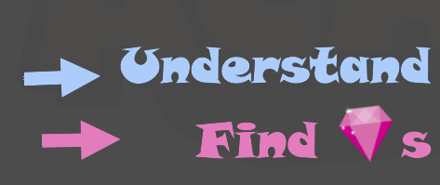
Let us find GEMs! Nehemiah 1: 1-6 Nehemiah 2 1-5,11, 15-17,19,20
Nehemiah (A call to rebuild)
S – Sin to confess P – Promise to claim A – Attitude to change C – Command to keep E – Example to follow P – Prayer to pray
E – Error to avoid
T – Truth to believe
S – Something to thank for
Linked GEM
Hymn GEM
Notes:
GUIDE ON USING THIS SLIDE: Just replace the verse and keep font-size the same
PURPOSE OF SLIDE: Guide the class servants and kids for the exact bible verses to read HOW TO OPERATE & TIPS:
- Children will sit on a circle and each child will read one verse
- Servants will guide, encourage and Support the kids – BUT Kids HAVE TO BE the ones reading.
- Tip to servant: Establish environment of RESPECT to anyone who reads even if they have less reading skills, set the stage upfront and let the kids know that GOD WILL LOVE TO HEAR THEIR READING regardless of how good they are.

Slide 5

Lessons Learned Today!
Find s
Who remembers Gems you found today?
Pray when in doubt or fearful.
Confess your sins in your prayers and to Abouna, and God will bless you, forgive you, and help you get better and fix them if possible ☺
Notes:
GUIDE ON USING THIS SLIDE: Only update the second bullet based on guide for this week lesson.
Keep font size and reduce text to fit only 1 line (less is more! – just keep key words)
PURPOSE OF SLIDE: Recap of what were the lesson learned
HOW TO OPERATE:
Servant to start with what the kids lesson findings and THANK THE KIDS for what they brought from the reading today
Servant then add the prepared key SINGLE lesson learned/symbol as per servant guide >> MAKE IT SHORT AND SWEET in 1 minute.
EXAMPLE:
Be Good even with to those who were bad to you and God will help you and protect you.
Forgiveness is amazing, God forgives us for our sins - let us learn to forgive others.
Love never fails.

Slide 6
Verse of the day
Memorize
“The God of heaven Himself will prosper us; therefore we His servants will arise and build”.
(Nehemiah 2:20)

Slide 7
See you next week!
Notes:
Close-off with excitement and love and instruct the kids to go back to the front-desk to get back their passports and workbooks.

