Slide 1
The Holy Gospel of St. Luke Chapters 10 & 11

Slide 2
Gospel Overview
Who is St. Luke?
Who is the audience of this Gospel?
What is the main takeaway of this Gospel?

Slide 3
Review - Chapter 9
Worry not, God takes care of our earthly needs
“Take nothing for the journey, neither staffs, nor bag nor bread nor money; and do not have two tunics apiece” – Luke 9:3
Discipleship
Deny self, follow Him, serve not be served
Least of us is greatest in God’s eyes, humility
God comes 1st, before family and friends. Ignore physical comfort
“If anyone would come after me, he must deny himself and take up his cross daily and follow me.” - Luke 9:2

Slide 4
Chapter 10 Outline
1-20: Appointing 70 apostles & their preaching
21-24: Lord Jesus rejoicing in the Spirit
25-37: The Good Samaritan
38-43: Martha the worker, Mary the sufferer

Slide 5
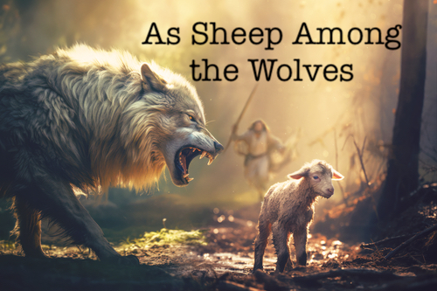
70 Apostles Sent Out (1)
70 vs 72 Apostles? Why so many?
Correlation to 12 tribes of Israel
Why 2 by 2 instead of 1 by 1?
Comfort, support, validation to the people
Similar instructions as the 12 Apostles, God will provide
Why “Greet no one along the road” – Luke 10:4
Distractions, long greetings.
Why “Remain in the same house” – Luke 10:7
Avoid competition among hosts
“Behold, I send you out as lambs among wolves.” - Luke 9:2

Slide 6
70 Apostles Sent Out (2)
Why “Remain in the same house” – Luke 10:7
Avoid competition among local hosts
Show the power of God through healing of the sick and announce the kingdom of God is at their door.
Capernaum, Bethsaida, and Chorazin
What happens to those who reject the apostles?
“Nevertheless do not rejoice in this, that the spirits are subject to you, but rather rejoice because your names are written in heaven.” - Luke 10:20
Earthly success is okay, but focus on promise of salvation

Slide 7
Jesus Rejoices in the Spirit
“In that hour Jesus rejoiced in the Spirit and said ‘I thank You, Father, Lord of heaven and earth…’” - Luke 10:21
Thrilled with joy over the work of his servants
Giving thanks to God and not praising oneself
“Blessed are the eyes which see the things you see; for I tell you that many prophets and kings have desired to see what you see, and have not seen it, and to hear what you hear, and have not heard it.” - Luke 10:23-24
Blessings of experiencing the ministry of the Lord Jesus Christ

Slide 8
The Lawyer Testing Jesus
“You shall love the Lord your God with all your heart, with all your soul, with all your strength, and with all your mind,’ and ‘your neighbor as yourself.’” - Luke 10:27
“You have answered rightly; do this and you will live.” - Luke 10:28
Relationship with God and relationship with others
Knowing the Word is not enough, one must follow it through their actions
“And who is my neighbor?” - Luke 10:29

Slide 9
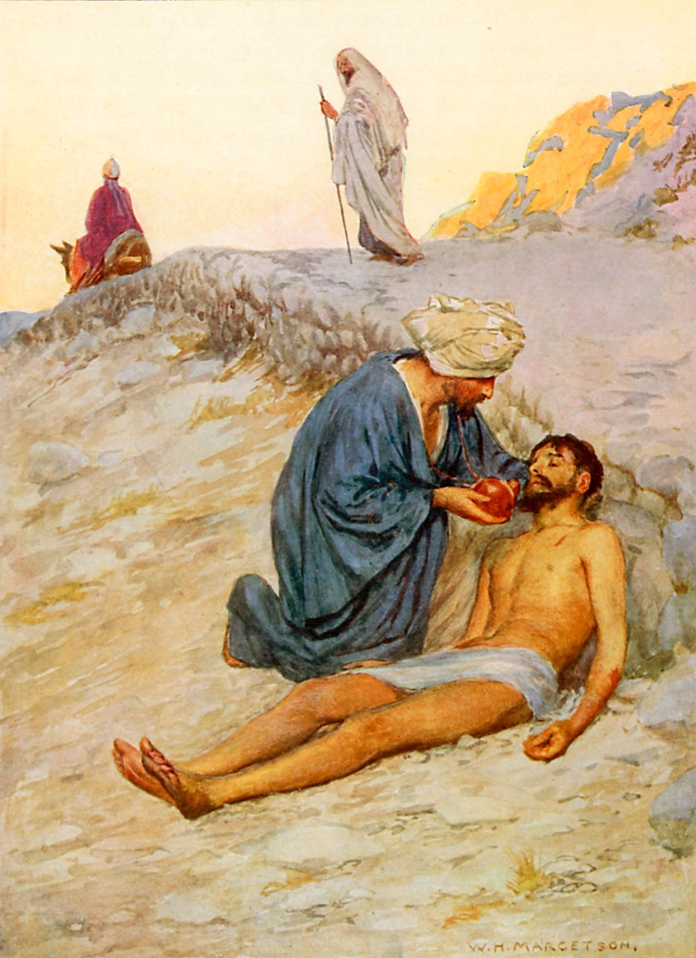
The Good Samaritan
Man traveling from Jerusalem to Jericho was robbed and beaten
Priest and Levite pass him by walking on the other side
The Samaritan had COMPASSION
Bandaged, poured oil & wine, put him on his animal, took him to an inn, and got a care taker the next day. Without being asked.
Sacrificed time, resources, and personal safety
Who was the neighbor?

Slide 10
The Good Samaritan - Takeaway
Be kindhearted and compassionate
Accept all mankind of every race as if they were relatives to us
Bandaged, poured oil & wine, put him on his animal, took him to an inn, and got a care taker the next day. Without being asked.
Sacrificed time, resources, and personal safety
Who was the neighbor?

Slide 11
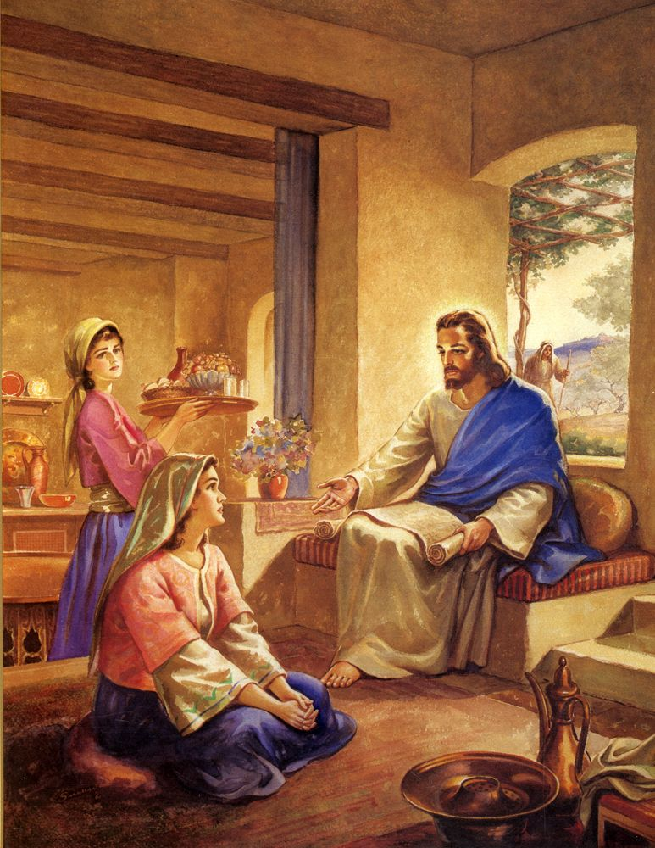
Mary & Martha
Martha serves the guests while Mary sits at Jesus’s feet; listening.
Do chores and regular personal responsibilities matter more than the spiritual ones?
Doing chores is admirable but not if they become a distraction from our spiritual devotion

Slide 12
Chapter 11 Outline
1-4: The Lord’s prayer
5-13: The fervent prayer
14-26: A house divided cannot stand
27-28: Friendship and the word of God
29-32: Seeking a sign
33-36: The healthy eye
37-54: The inner purity & the worship by the Spirit

Slide 13
How to Pray
“Our” not “My” Father → Praying for others vs praying for oneself
“They Kingdom Come” → Asking for the end of the world or God’s kingdom be in our lives?
“Our Daily Bread” → What is this bread?
“So I say to you, ask, and it will be given to you; seek, and you will find; knock, and it will be opened to you. For everyone who asks receives, and he who seeks finds, and to him who knocks it will be opened.” - Luke 11:9-10
Don’t give up, always pray. Ask, Seek, and Knock
Evil doers can still give good gifts
Compared to earthly fathers, the heavenly Father gives the Holy Spirit to those who ask Him

Slide 14
A House Divided Cannot Stand
Religious leaders accuse Jesus of working with Beelzebub to cast out demons
Jesus uses logic to dismiss their argument
“Every kingdom divided against itself is brought to desolation, and a house divided against a house falls.” - Luke 11:17
“And if I cast out demons by Beelzebub, by whom do your sons cast them out?” - Luke 11:19
Evil does not fight evil, it unites against good.
“He who is not with Me is against Me, and he who does not gather with Me scatters.” - Luke 10:23

Slide 15
Inner Purity (1)
Jesus is invited to dine with a Pharisee but did not wash his hands first.
“Now you Pharisees make the outside of the cup and dish clean, but you inward part is full of greed and wickedness.” - Luke 11:39
Ceremonial acts do not purify, instead, it’s our love for our heavenly Father and neighbors that purify us.
Selfishness vs unselfishness
“Woe to you Pharisees! For you love the best seats in the synagogues and greetings in the marketplaces.” - Luke 11:43
Pride, hypocracy, societal status, and overburdening men

Slide 16
Inner Purity (2)

Slide 17
What Really Counts? (1)
A group sitting at table in a school cafeteria are shocked. Rhonda, Kirby, Marty, Lisa, Rick, Jason,
Rhonda: “I don’t believe it”
Kirby: “Well, it’s true, I heard it on the radio during my free period. Kyle Wallace has been arrested for shoplifting.”
Rhonda: “I still don’t believe it, Kyle goes to my church!”
Marty: “That’s right. He’s always inviting me to go with him to your youth group meetings.”
Lisa: “And I know for a fact that he gives the church 10% of his wages from the department store. Anyone that scrupulous about – what’s it called, ‘tithing’? - couldn’t be involved in something like stealing.”

Slide 18
What Really Counts? (2)
Rick: “I’ve even seen him read his Bible during study hall. He takes a lot of teasing for that from the other guys.”
Jason who had been listening quietly to the others talk, finally said
Jason: “Kyle is religious, all right. But I don’t think any of you knew him as well as I do. Inside, well, he’s something different. This news doesn’t surprise me much.”
Rhonda: “Wait a minute, are you saying that all that religion is a show?”

Slide 19
What Really Counts? (3)
Jason: “Not exactly, but kinda. He isn’t really lying. It’s just that he sorta keeps the two parts of his life separated. The outside part is religious. The inside part is something else.”
A few moments of silence fell on the group
Marty: “I guess you just never know what someone is like on the inside, do you?”
Lisa: “No. And it’s the inside the counts, isn’t it?”

Slide 20
Scenario Discussion
Have you ever known anyone like Kyle?
Can you really tell if someone is a Christian by their actions?
Do you think it’s easy to fool your friends like he did?
Why would someone want to maintain a false image of religious devotion?

Slide 21
Group Discussion
What are things that make a person appear religious on the outside?
What are things that determine a person’s spirituality on the inside?
Is it possible for someone to appear religious on the outside without appearing so on the inside? How?
Is it possible for someone to be spiritual on the inside without appearing so on the outside? How?

Slide 22
Group Discussion - Transparent Thoughts
Imagine our forehead is screen showing our thoughts. Would your friends be:
Shocked at the difference between what you appear to be on the outside and what you really are on the inside?
Somewhat surprised that your inner thoughts don’t stack up to what you appear to be on the outside?
Amused at some of the differences at what you appear to be and what you really are?
Not the least surprised by what your “forehead screen” reveals?
Reassured that you are the same person inside as you appear to be outside?

Slide 23
Summary + Memory Verse
Dear Lord, I know you can see the screen of what the true me is, you can read my thoughts and intentions, help me work to purify the inside of me so that my screen shows a good person inside out not a good person outside only but has a dark heart. I wish I am like the good Samaritan who helped the needy without waiting to be noticed or rewarded. I wish I am like Mary who sat by your feet quietly not trying to grab the attention of anyone but enjoy her time with you.
“Therefore take heed that the light which is in you is not darkness.” - Luke 11:35

