Slide 1
Bible Study
Luke – Chapter 9

Slide 2
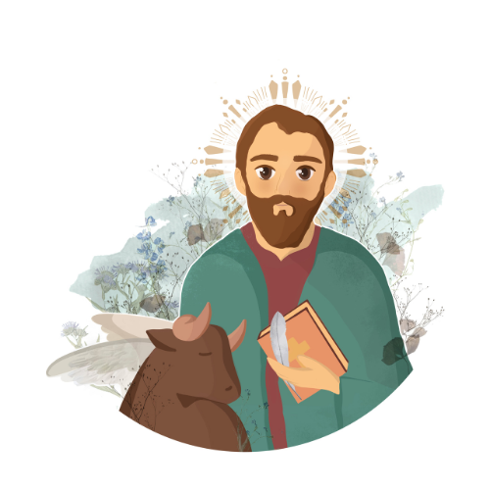

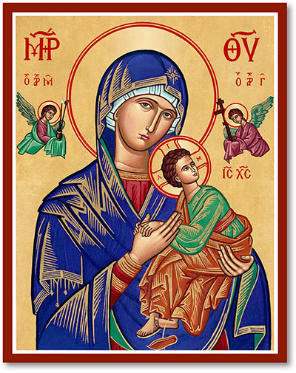

Notes:
Who is the writer of the Gospel?
What is the Symbol and why ? The ox associated with the Gospel of Luke fits well since it speaks to the great sacrifice of Jesus, and the ox was an important animal for sacrifice as required in the Torah.

Slide 3
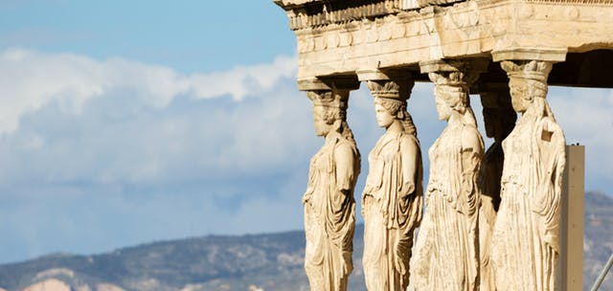

Slide 5
Summary of Chapter 8

Slide 6
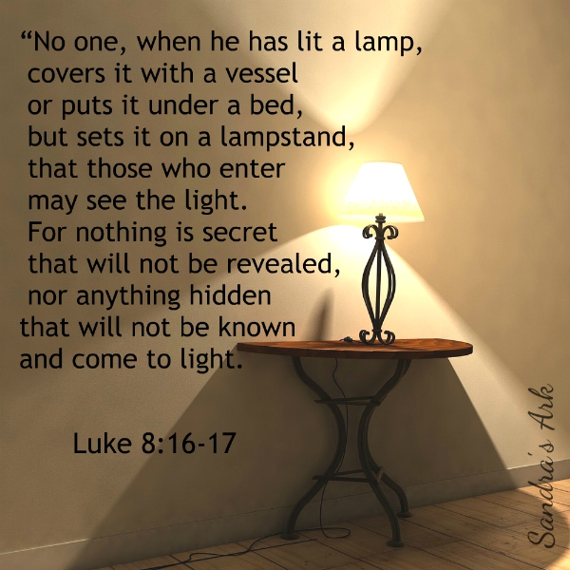
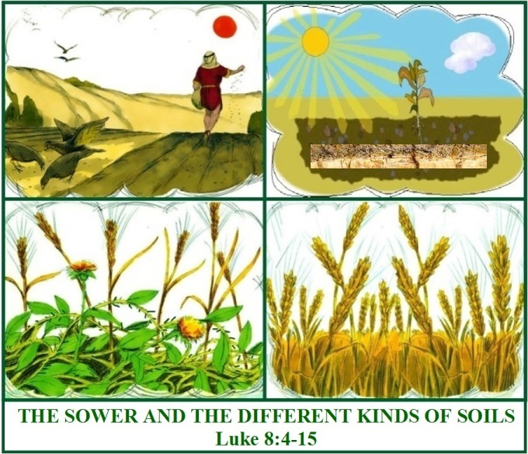

Slide 7
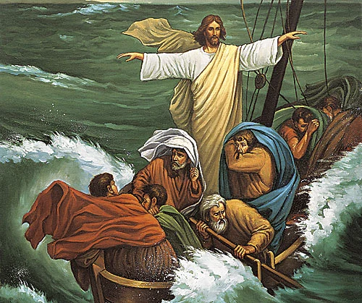
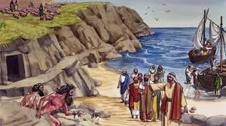

Slide 8
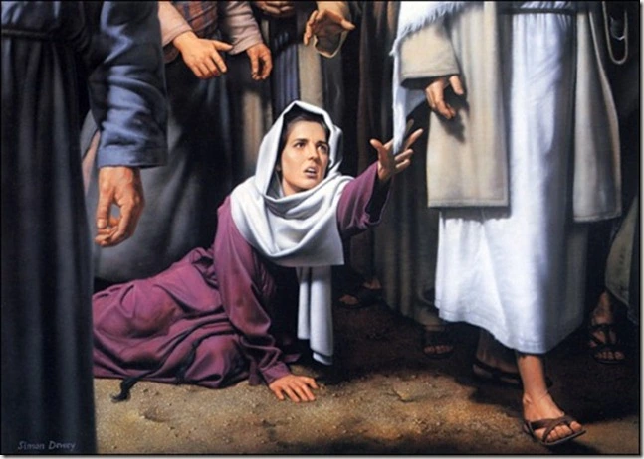
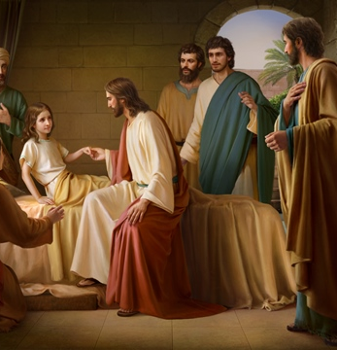

Slide 9
Our Takeaway from Chapter 8
Christ looks at our heart and our faith regardless of our status

Slide 10
Overview of Chapter 9

Slide 11
Breakdown of Chapter 9
Event | Verses
The Sending of the Disciples | 1-7
Herod’s Confusion | 7-9
The Disciples & the Feeding of the Multitudes | 10-18
The Disciples knowing Christ | 19-21
Discipleship & the Cross | 22-27
The Disciples & the Transfiguration | 28-36

Slide 12
Breakdown of Chapter 9 (cntd.)
Event | Verses
The Disciples & the Casting out of Evil Spirits | 37-43
The Disciples & the Handing over of the Son of Man | 44-45
The Disciples Wonder about Greatness | 46-48
The Disciples & Sectarianism | 49-50
The Disciples & the Rejection of a Samaritan Village | 51-56
Conditions of Discipleship | 57-62

Slide 13
Breakdown of Chapter 9
Event | Verses
The Sending of the Disciples | 1-7
Herod’s Confusion | 7-9
The Disciples & the Feeding of the Multitudes | 10-18
The Disciples knowing Christ | 19-21
Discipleship & the Cross | 22-27
The Disciples & the Transfiguration | 28-36

Slide 14
Breakdown of Chapter 9 (cntd.)
Event | Verses
The Disciples & the Casting out of Evil Spirits | 37-43
The Disciples & the Handing over of the Son of Man | 44-45
The Disciples Wonder about Greatness | 46-48
The Disciples & Sectarianism | 49-50
The Disciples & the Rejection of a Samaritan Village | 51-56
Conditions of Discipleship | 57-62

Slide 15
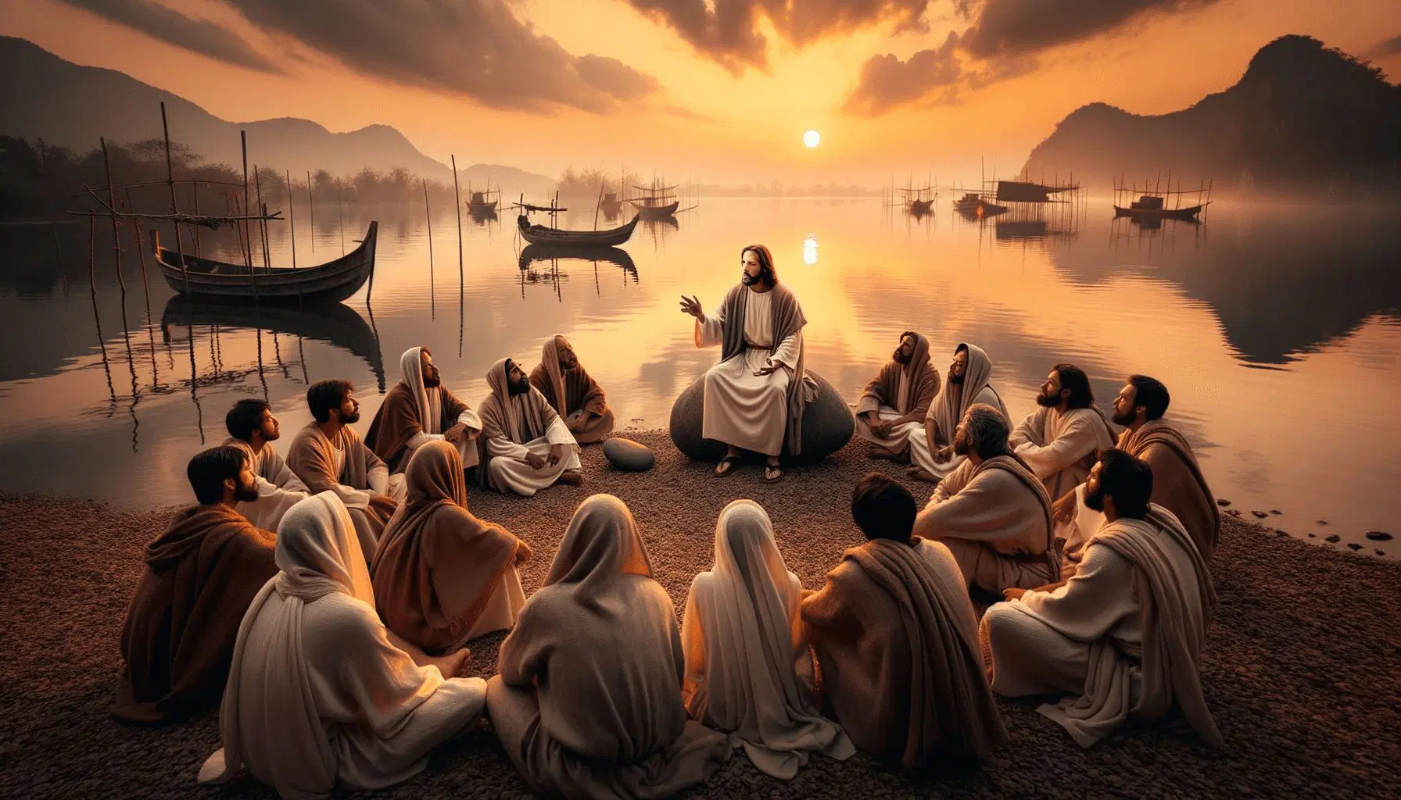

Slide 16
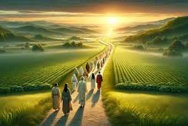
DISCIPLESHIP

Slide 17

Let us go

Slide 18
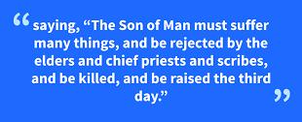
Christ Predicts His Death and Resurrection
(Luke 8:22)
Notes:
Instead of traveling down the eastern side of the Jordan River to avoid passing through Samaria, Jesus and His disciples are traveling the more dangerous route through Samaria on the way to Jerusalem

Slide 19
A Primer on Discipleship

Slide 20
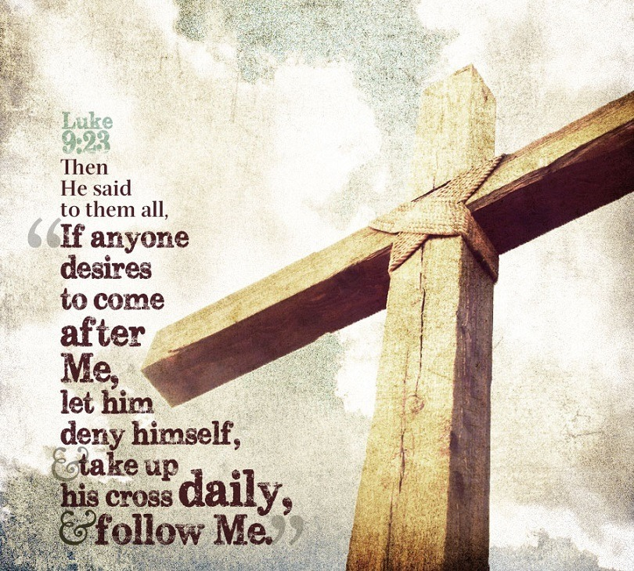

Slide 21
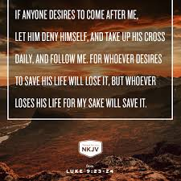

Slide 22
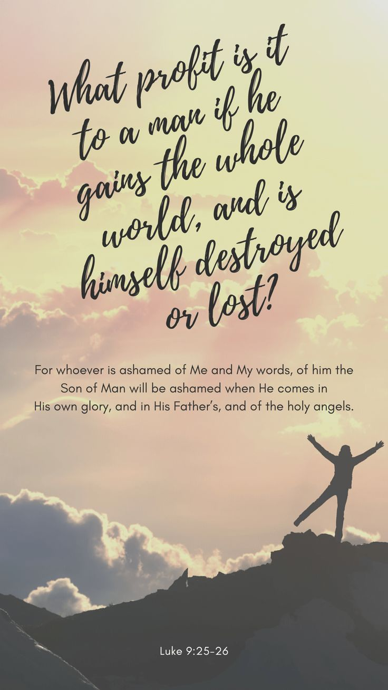

Slide 23
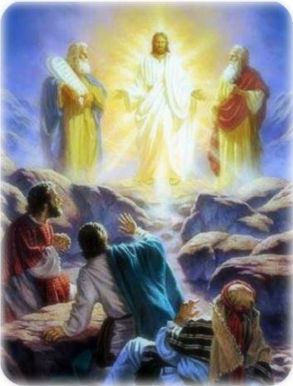
The Transfiguration

Slide 24
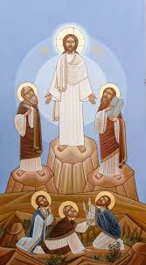
What is the Transfiguration of Christ?
A minor feast!
Celebrated on Mesra 13th (19th of August)
They saw His glory; “they” refers to Peter, John, and James
How can I see His glory?
Notes:
Note the

Slide 25
They saw His Glory (v. 32)
Verse 28: about 8 days after …; … went up
Verse 29: As He prayed, the appearance of His Face was altered, and His robe became white and glistening.
Verse 32: … and when they were fully awake, they saw His glory …
Verse 33: …“Master, it is good for us to be here …”
Verse 35: And a voice came out of the cloud, saying, “This is my beloved Son. Hear Him!”
Notes:
8 days symbolizes the Resurrection: Eternity; anything beyond the human perfection (7 days)
We need to go up to see the glory of Christ. Up to the mountain – up to the altar
Taking a step up every day and every week

Slide 26
How can I see His Glory?
Verse 28:
  We need to focus on eternity through the power of His resurrection.
  We need to keep moving towards God every day – towards His altar.
Verse 29: We need to pray. We learn to pray through prayer.
Verse 32: We need to be alert in our spiritual life.
Verse 33: We need to enjoy our time with God.
Verse 35: Then, God will reveal Himself in His glory and authority to us and will comfort us.
Notes:
8 days symbolizes the Resurrection: Eternity; anything beyond the human perfection (7 days)
We need to go up to see the glory of Christ. Up to the mountain – up to the altar
Taking a step up every day and every week

Slide 27
More Lessons about Discipleship

Slide 28
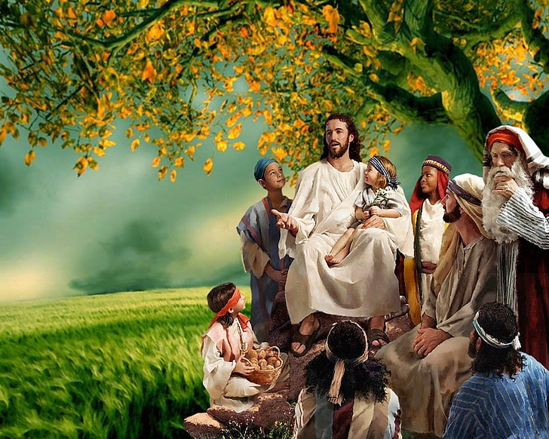
Who would be the Greatest?
⁴⁶ Then a dispute arose among them as to which of them would be greatest. ⁴⁷ And Jesus, perceiving the thought of their heart, took a little child and set him by Him, ⁴⁸ and said to them, “Whoever receives this little child in My name receives Me; and whoever receives Me receives Him who sent Me. For he who is least among you all will be great.”

Slide 29
The Disciples and Sectarianism
  Verses 49-50
  “Forbid him not. Our Lord is not moved by this event, to teach us that perfect virtue entertains no thoughts of revenge, and that anger cannot be found where the fulness of charity reigns. The weak must not be driven away but assisted. Let the breast of the religious man be ever unmoved by passion, and the mind of the generous undisturbed by desires of revenge.” St. Ambrose

Slide 30
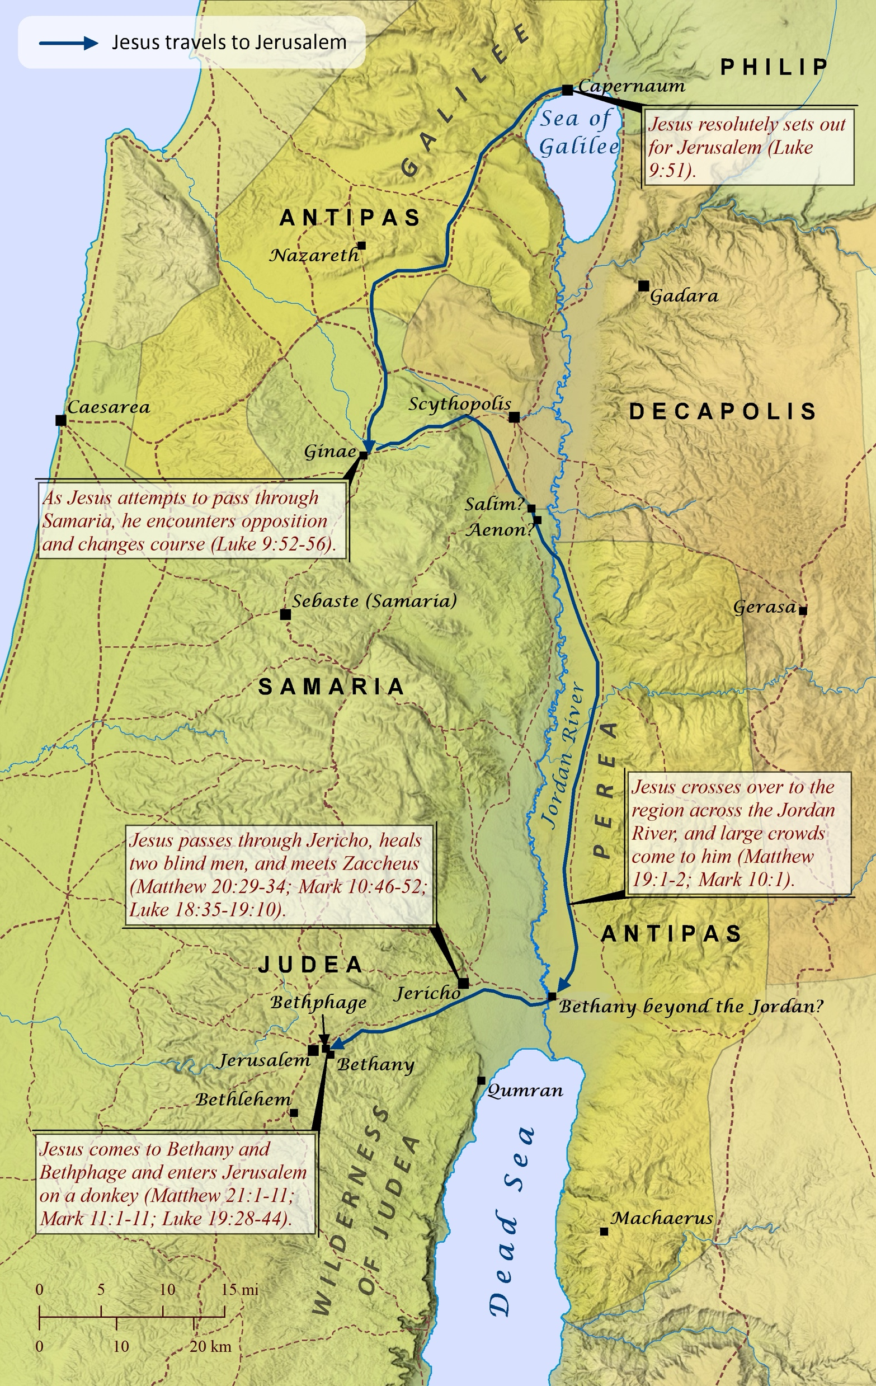
A Samaritan Village Rejects the Savior
Verses 51-56
Christ making His way to Jerusalem
Taking the route that passes through Samaria
He faces rejection
Notes:
Instead of traveling down the eastern side of the Jordan River to avoid passing through Samaria, Jesus and His disciples are traveling the more dangerous route through Samaria on the way to Jerusalem

Slide 31
Let us pause a little …
The Zebedee brothers' desire to punish the offenders with fire brings to mind the story of the prophet Elijah in dispensing judgment in 2 King 1:1-12
Jesus explained to them that their failing at this point came in two ways:
  They didn’t know themselves, perhaps they thought they were being like Jesus, or showing the character of God. They were mistaken, and did not represent God and His heart
    He loved the Samaritans and wanted them to repent and be saved
  They didn’t know Jesus and His mission, He came to save the lost, not to burn them up with fire from heaven
Notes:
Note the

Slide 32
Conditions of Discipleship

Slide 33
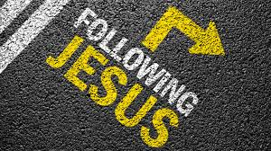
Following our Lord Jesus Christ
First Example – Verses 57-58:
  Our decision cannot be built on momentary emotions.
  We need to follow Him for His person not forany other gain or comfort or honor that will come along.
Second Example – Verses 59-60:
  Our priorities need to be clear.
  Christ needs to be at the center of all other responsibilities & relationships.
Notes:
8 days symbolizes the Resurrection: Eternity; anything beyond the human perfection (7 days)
We need to go up to see the glory of Christ. Up to the mountain – up to the altar
Taking a step up every day and every week

Slide 34
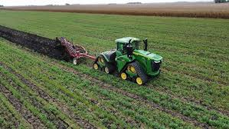
Following our Lord Jesus Christ – Cntd.
Third Example – Verses 61-62:
  We need to be serious.
  We need to focus on our goal and look forward.
Notes:
8 days symbolizes the Resurrection: Eternity; anything beyond the human perfection (7 days)
We need to go up to see the glory of Christ. Up to the mountain – up to the altar
Taking a step up every day and every week

Slide 35

Our Lord invites us to be His disciples, His friends, and His chosen ones.
We need to follow in His footsteps and learn His heart!
God will reveal His glory to us and make us enjoy His fellowship.
Review our heart in view of His heart and teachings.

