Slide 1
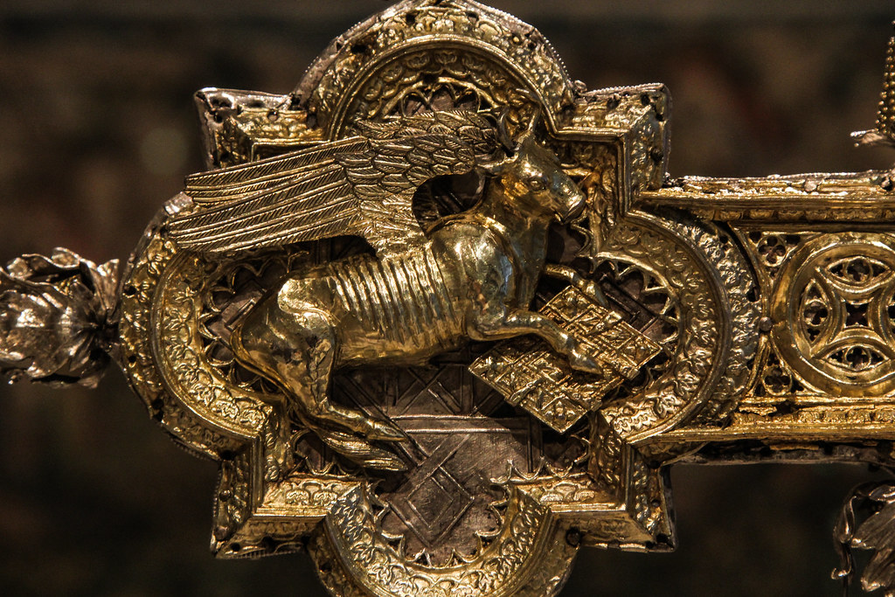
Chapter 1

Slide 2
Introduction
To whom it was written ----Greeks
Subject -------Christ the lover of mankind.
Main message of Jesus -------Saves mankind.
Gospel content -------Focused on History.
Symbol ------The OX. The ox associated with the Gospel of Luke fits well since it speaks to the great sacrifice of Jesus, and the ox was an important animal for sacrifice as required in the Torah.

Slide 3
Continue to introduction:
Who is St. Luke?
He was a doctor, a painter, and a Gentile from Antioch. He accepted Christianity at the hands of St. Paul the apostle later after resurrection.
Who did he write his gospel to?
The Greek after collecting testimonies from eyewitnesses to accurately record all details of Jesus life.
What is the main message of the book?
St Luke offered Jesus to the Greeks as a Lover of mankind, who cares for the educated and uneducated, the philosopher and the unwise, the rich and the poor, the Jew and the Gentile, the man, the woman and the child.

Slide 5
Learn to submit to God’s will !!

