Slide 1
Bible Study
MS Class 10/4/2024
Luke - Chapter 2

Slide 2
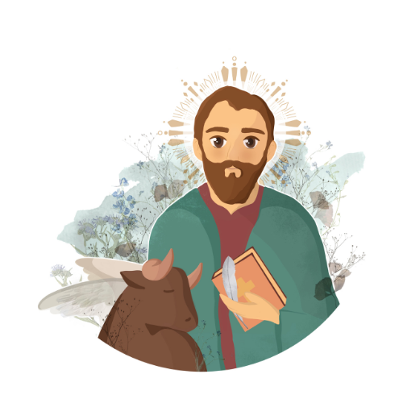
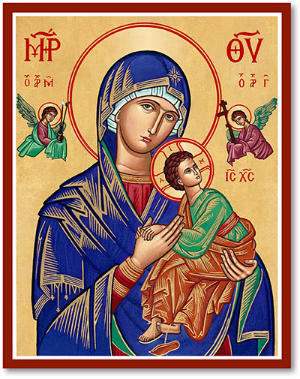


Notes:
Who is the writer of the Gospel?
What is the Symbol and why ? The ox associated with the Gospel of Luke fits well since it speaks to the great sacrifice of Jesus, and the ox was an important animal for sacrifice as required in the Torah.

Slide 3
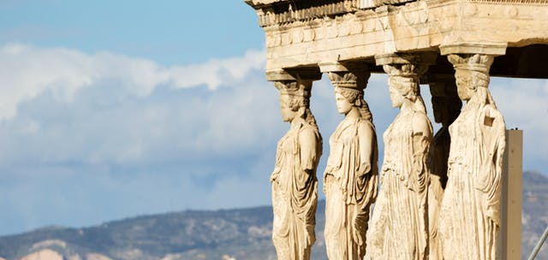

Slide 5
Summary of Chapter 1

Slide 6
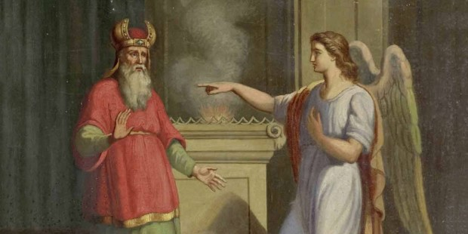
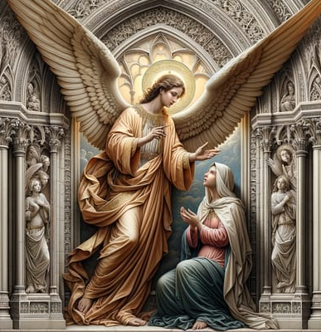

Slide 7
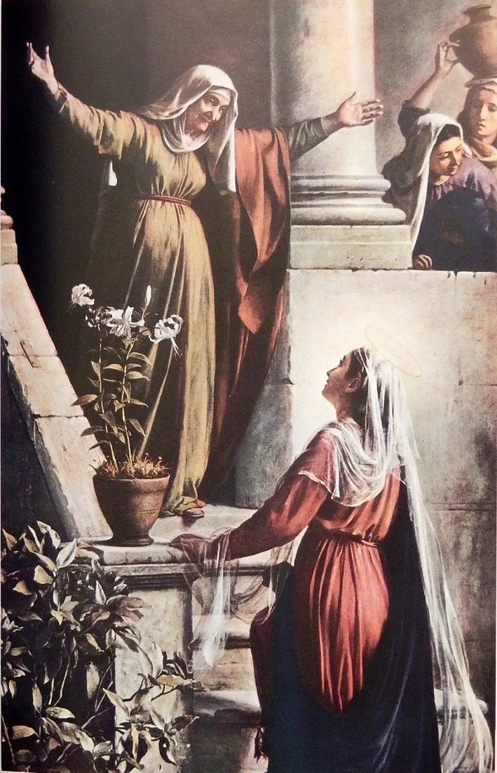
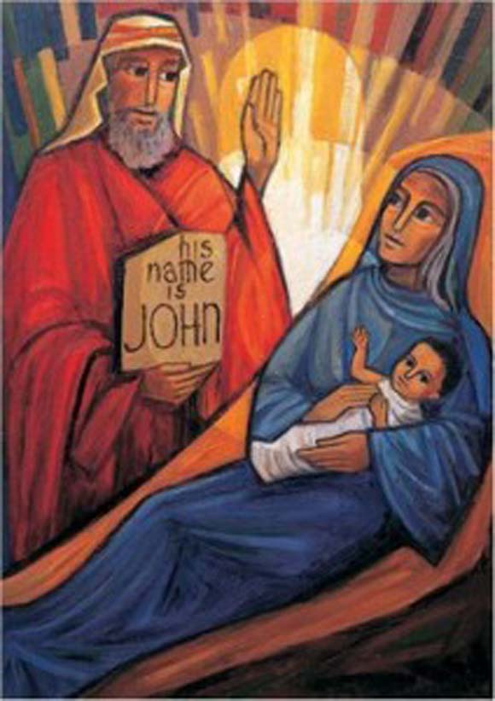

Slide 8
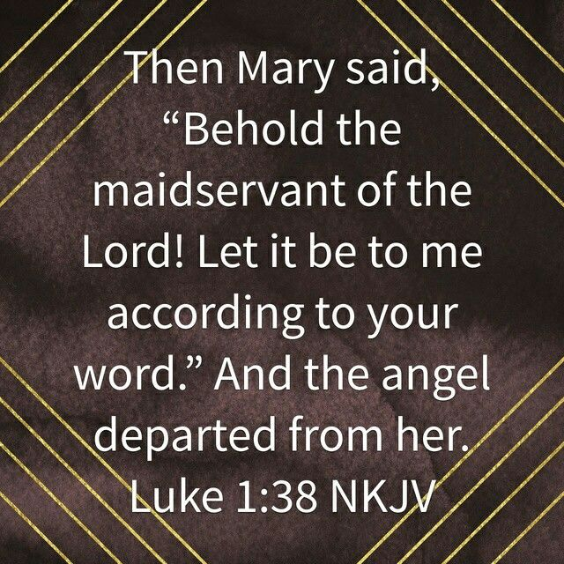
Our Takeaway from Chapter 1
How Submissive am I to God and His word?

Slide 9
Overview of Chapter 2

Slide 10
Breakdown of Chapter 2
Event | Verses
The Birth of our Lord Jesus Christ | 1-7
The Announcement to the Shepherds | 8-20
Our Lord’s Circumcision | 21
The Sacrifice Offering (on the 40th day) | 22-24
The Praise of Simon the Elder | 25-35
The Praise of Hannah the Daughter of Phanuel | 36-38
The Return to Nazareth | 39-40
Christ in the Temple | 41-52

Slide 11
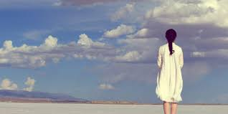
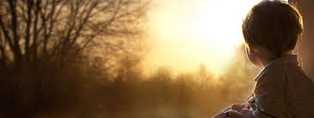

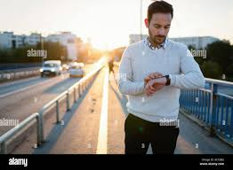
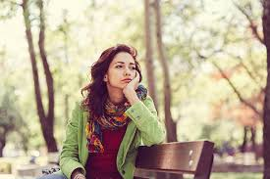

Slide 12

WAITING

Slide 13

Let us dive into Chapter 2

Slide 14
Christ’s Birth

Slide 15
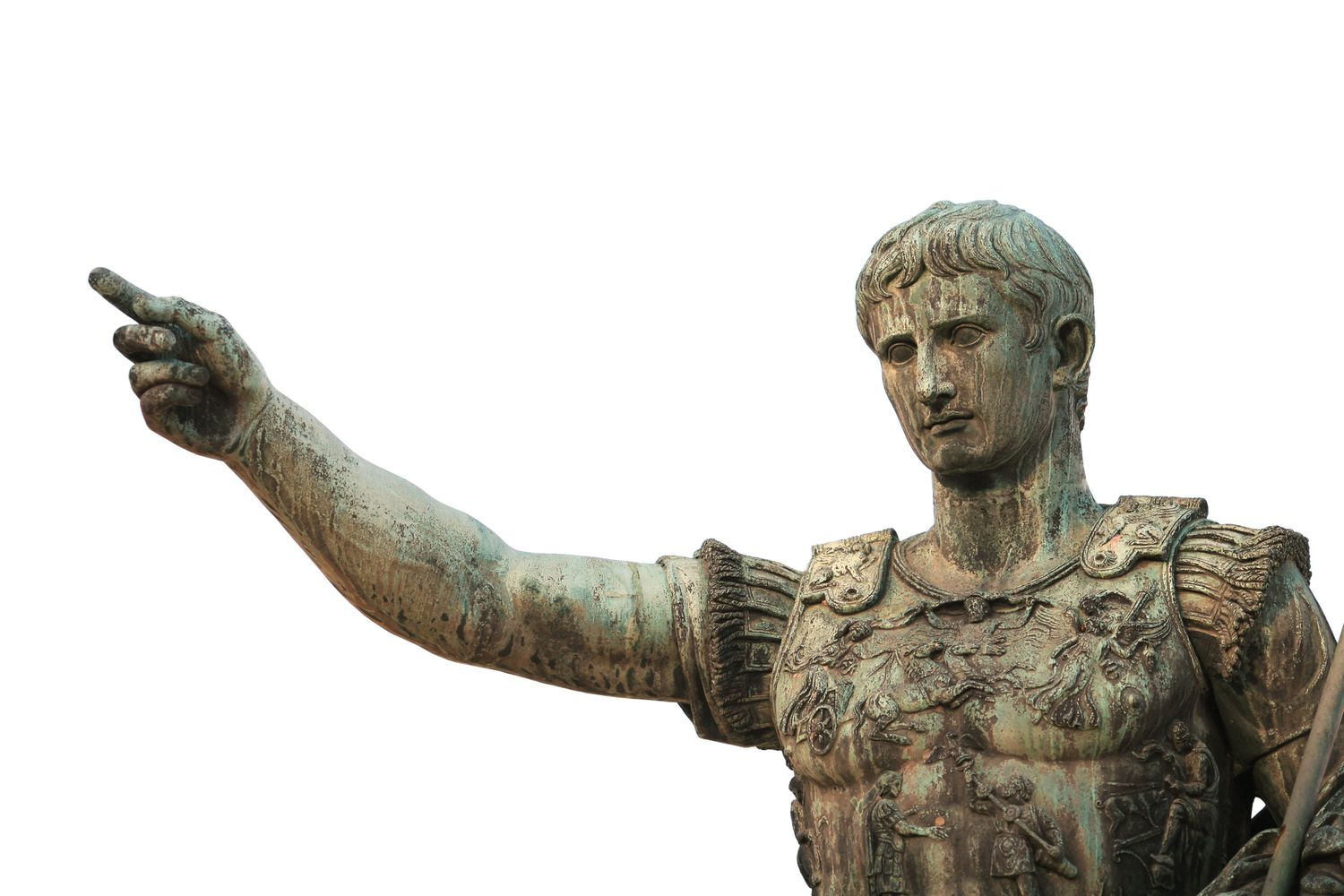
Census?

Slide 16
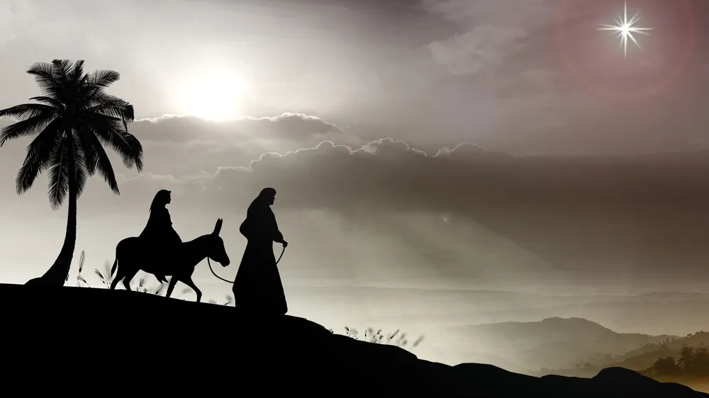

Slide 17
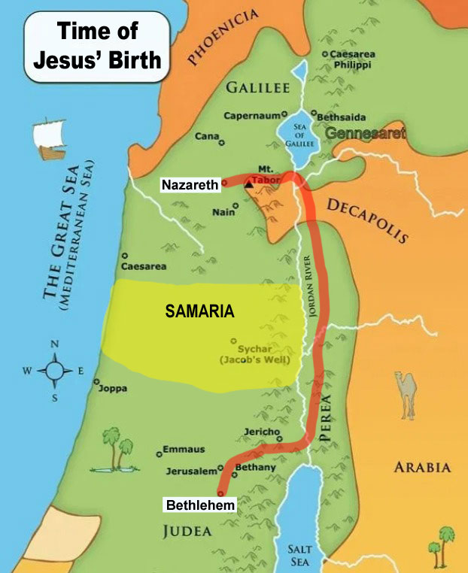
The Trip to Bethlehem in Judea
Because of a decree by the Roman ruler
Performed according to a Jewish regime
A tedious journey (around 70-90 miles)
Micah 5:2 – Prophecy fulfilled!
Notes:
Note the

Slide 18
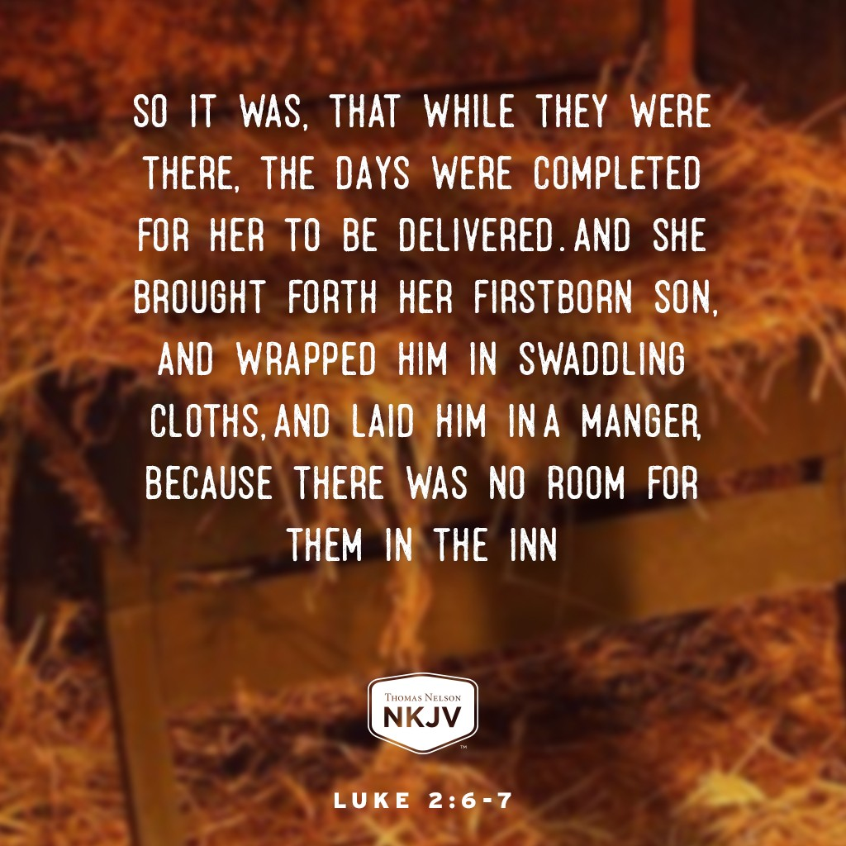

Slide 19
Let us pause a little …
She brought forth her firstborn
  Firstborn means he who has not been preceded by anyone in birth
  “the firstborn from the dead” (Col 1:18)
There was no room for them in the inn
  “that though He was rich, yet for your sakes He became poor, that you through his poverty might be rich” (2 Cor 8:9)
  He took what is ours and gave us what is His, we praise and glorify Him, and exalt Him – Friday theotokia.
Notes:
Note the

Slide 20
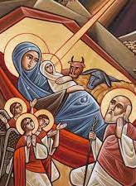
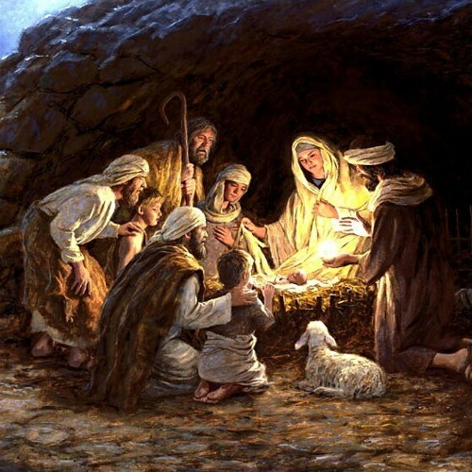

Slide 21
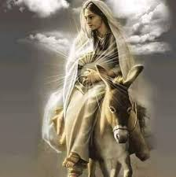
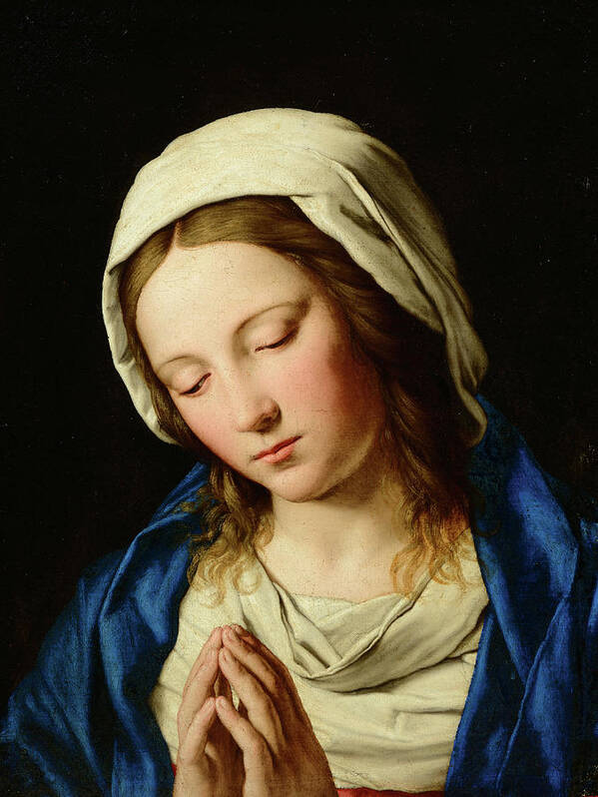
St. Mary & St. Joseph were waiting on God
Notes:
Note the

Slide 22
Who was first to get the news?

Slide 23
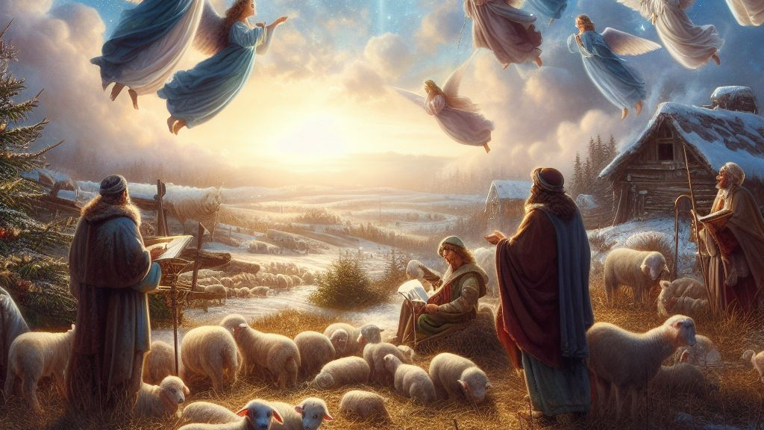
The Announcement to the Shepherds
Notes:
Note the

Slide 24
Let us get into the details …
Verse 8: Now there were in the same country shepherds living out in the fields, keeping watch over their flock by night
  Being Alert (at night)
  Caring for their flock
Verses 9-10
  God will take away our fear before He talks to us
Verses 10-14
  They get special promises
Verses 15-20
  The shepherds go to Christ – St. Mary waiting on GOD
Notes:
How do I spend my evening?
It shows if I am waiting on God or not.

Slide 25
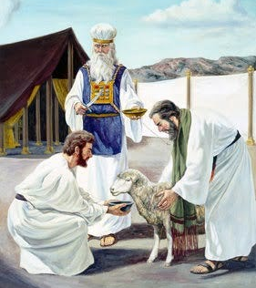
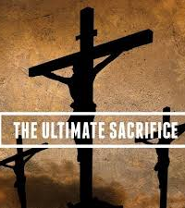

Slide 26
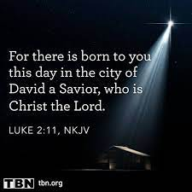

Slide 27
Christ was born for everyone, but not everyone receives His birth

Slide 28
The Circumcision of our Lord

Slide 29
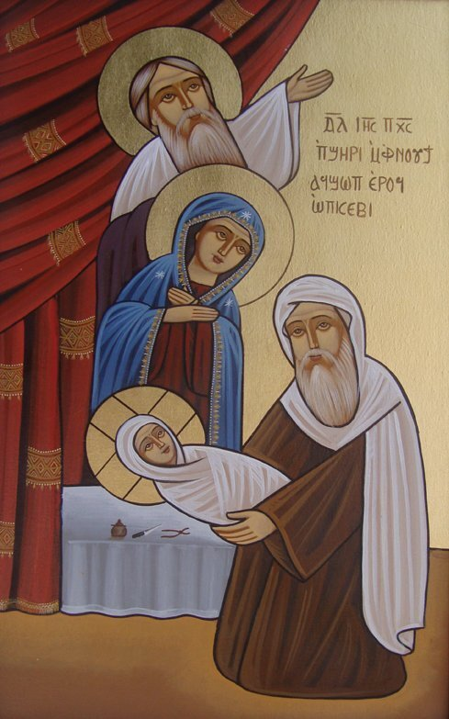

Slide 30
Our Lord Presented in the Temple on the 40th Day

Slide 31
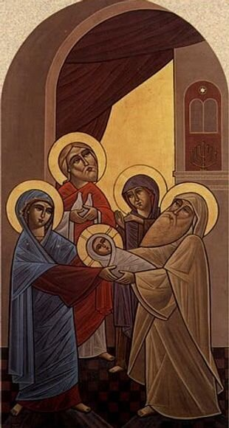
Simeon was WAITING for the consolation of Israel
  The 12th Hour of the Agpeya
    Are we ready every night to meet Christ?
  One of the 72 elders who translated the Old Testament from Hebrew to Greek – had trouble translating “a virgin will..
  An interesting waiting – A promise fulfilled!
  When we take the word of God as true, God will show us the TRUTH!

Slide 32
Anna, the daughter of Phanuel
  A widow of about 84 years
  Did not depart from the temple, but served God with fastings and prayers night and day
  Spoke of Him to all who looked for redemption in Jerusalem
You never wait in vain when
you wait for God!

Slide 33

God comes to us where we are – He come to the manger, He come to the shepherd in the fields at night, and He came to Simeon and Anna at the temple.
If we are waiting for His birth, we will receive His salvation!
You never wait in vain when you wait for God.
Don’t leave God until you get what you want.

